Slide 1
Neo4J and Cypher
UNIT-5

Slide 2
What Is a Graph
Graphs Represent Entities As Nodes And The Ways In Which Those Entities Relate To The World As Relationships.
This General-purpose, Expressive Structure Allows Us To Model All Kinds Of Scenarios, From The Construction Of A Space Rocket, To A System Of Roads, And From The Supplychain Or Provenance Of Foodstuff, To Medical History For Populations, And Beyond

Slide 3
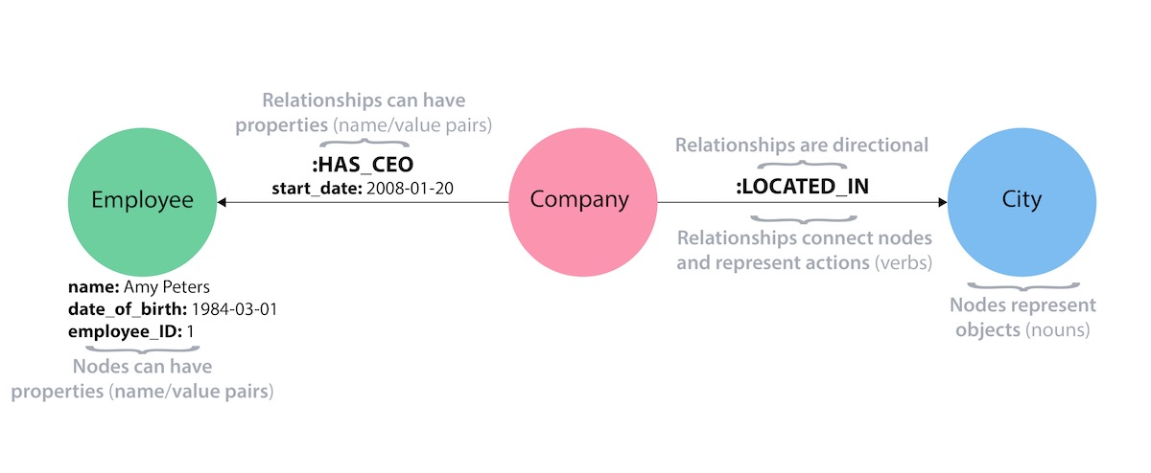

Slide 4
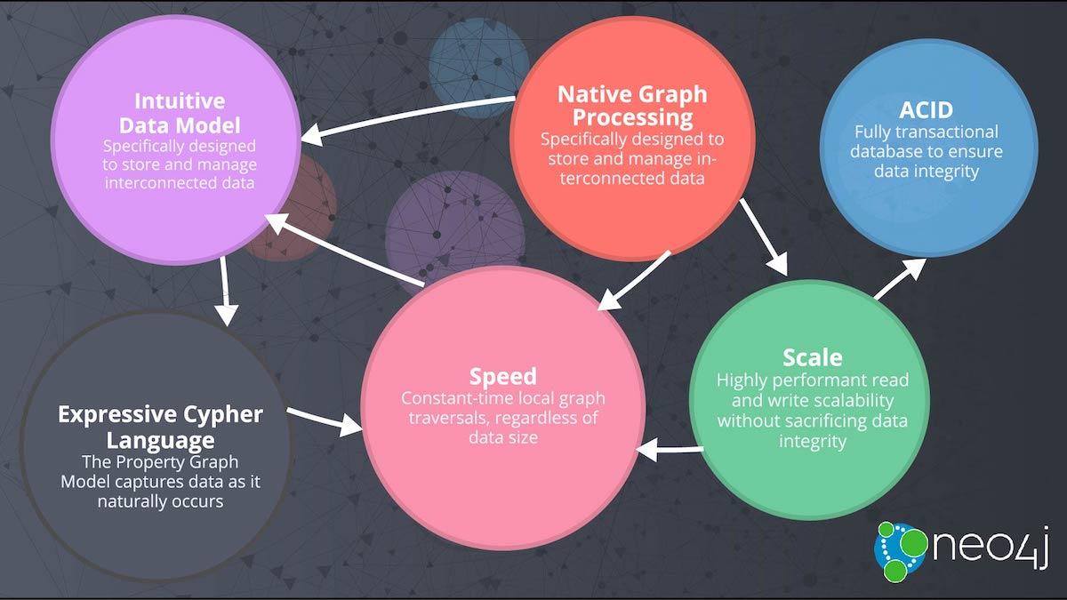

Slide 5
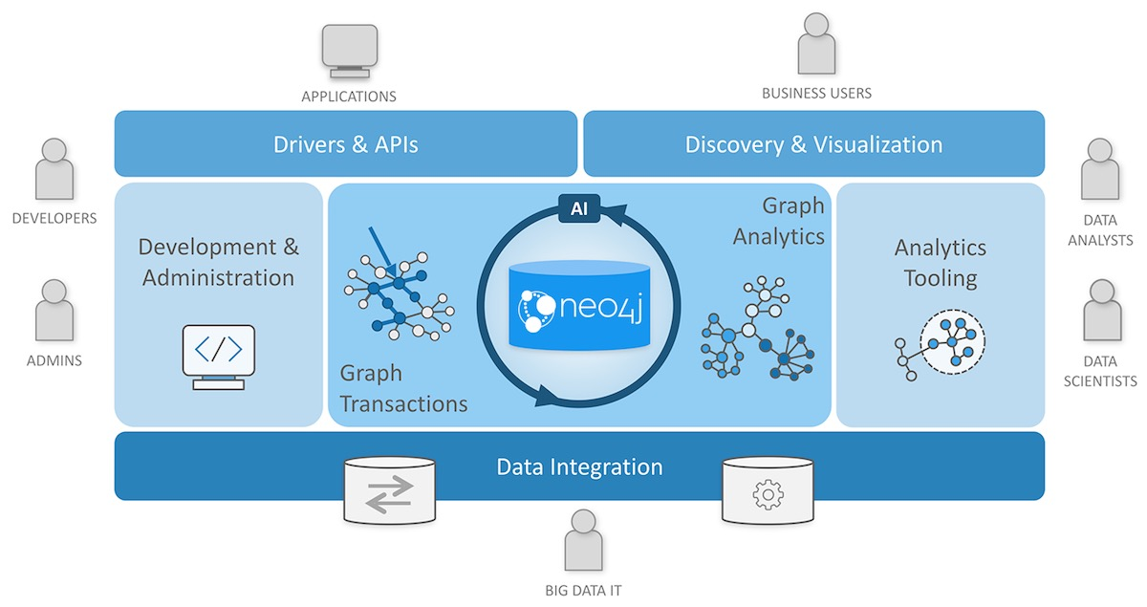

Slide 7
The Labeled Property Graph Model
The Most Popular Form Of Graph Model, The Labeled Property Graph
A Labeled Property Graph Has The Following Characteristics:
• It Contains Nodes And Relationships.
• Nodes Contain Properties (Key-value Pairs).
• Nodes Can Be Labeled With One Or More Labels.
• Relationships Are Named And Directed, And Always Have A Start And End Node.
• Relationships Can Also Contain Properties
A High-Level View of the Graph Space
Numerous projects and products for managing, processing, and analyzing graphs have exploded onto the scene in recent years
The sheer number of technologies makes it difficult to keep track of these tools and how they differ, even for those of us who are active in the space

Slide 8
Technologies used primarily for transactional online graph persistence, typically accessed directly in real time from an application these technologies are called graph databases
Graph Databases:
A graph database management system is an online database management system with create, read, update, and delete (CRUD) methods that expose a graph data model.
Graph databases are generally built for use with transactional (OLTP) systems, they are normally optimized for transactional performance, and engineered with transactional integrity and operational availability in mind.
properties of graph databases
THE UNDERLYING STORAGE
Graph databases use native graph storage that is optimized and designed for storing and managing graphs
Some serialize the graph data into a relational database, an object-oriented database, or some other general-purpose data store.
The processing engine
. A graph database use index-free adjacency, meaning that connected nodes physically “point” to each other in the database

Slide 9
Relationships are first-class citizens of the graph data model. This is not the case in other database management systems, where we have to infer connections between entities using things like foreign keys or out-of-band processing such as map-reduce.
Assembling the simple abstractions of nodes and relationships into connected structures, graph databases enable us to build arbitrarily sophisticated models that map closely to our problem domain.
The resulting models are simpler and at the same time more expressive than those produced using traditional relational databases and the other NOSQL (not only SQL) stores.

Slide 10
An overview of the graph database space

Slide 11
Graph Compute Engines
A Graph compute engine is a technology that enables global graph computational algorithms To be run against large datasets. Graph compute engines are designed to do Things like identify clusters in your data, or answer questions such as,
“how many Relationships, on average, does everyone in a social network have?”
Graph compute engines are normally optimized for scanning and processing large amounts of information in batches, and in that respect they are similar to other batch analysis technologies, such as data mining and OLAP, in use in the relational world.

Slide 12
A variety of different types of graph compute engines exist. Most notably there are in memory/ single machine graph compute engines like cassovary and distributed graph compute engines like pegasus or giraph.
Most distributed graph compute engines are based on the pregel white paper, authored by google, which describes the graph compute engine google uses to rank pages
The Labeled Property Graph Model-salient features:
A labeled property graph is made up of nodes, relationships, properties, and labels.
Nodes contain properties. Think of nodes as documents that store properties in the form of arbitrary key-value pairs. In neo4j, the keys are strings and the values are the java string and primitive data types, plus arrays of these types
Nodes can be tagged with one or more labels. Labels group nodes together, and indicate the roles they play within the dataset
Relationships connect nodes and structure the graph. A relationship always has a direction, a single name, and a start node and an end node—there are no dangling relationships. Together, a relationship’s direction and name add semantic clarity to the structuring of nodes.
Like nodes, relationships can also have properties. The ability to add properties to relationships is particularly useful for providing additional metadata for graph algorithms, adding additional semantics to relationships (including quality and weight), and for constraining queries at runtime.

Slide 13
Querying Graphs: An Introduction to Cypher
Cypher is an expressive (yet compact) graph database query language
Currently specific to neo4j, its close affinity with our habit of representing graphs as diagrams makes it ideal for programmatically describing graphs
Cypher Philosophy
Cypher is designed to be easily read and understood by developers, database professionals,and business stakeholders
Cypher enables a user (or an application acting on behalf of a user) to ask the database to find data that matches a specific pattern

Slide 14
(emil)<-[:KNOWS]-(jim)-[:KNOWS]->(ian)-[:KNOWS]->(emil)
Property graph model, where data is organized as nodes, relationships, and properties
Nodes are the entities in the graph. They can hold any number of attributes (key-value pairs) called properties. Nodes can be tagged with labels, representing their different roles in your domain. Node labels may also serve to attach metadata (such as index or constraint information) to certain nodes.
Relationships provide directed, named, semantically-relevant connections between two node entities (e.G. Employee WORKS_FOR company).
A relationship always has a direction, a type, a start node, and an end node. Like nodes, relationships can also have properties. In most cases, relationships have quantitative properties, such as weights, costs, distances, ratings, time intervals, or strengths.
Due to the efficient way relationships are stored, two nodes can share any number or type of relationships without sacrificing performance. Although they are stored in a specific direction, relationships can always be navigated efficiently in either direction

Slide 15
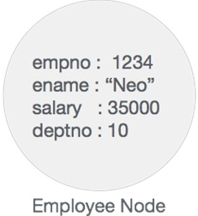
Neo4j Graph Database has the following building blocks −
Nodes
Properties
Relationships
Labels
Data browser
NODE
Node is a fundamental unit of a graph. It contains properties with key-value pairs as shown in the following image
Node Name = "Employee" and it contains a set of properties as key-value pairs..

Slide 16
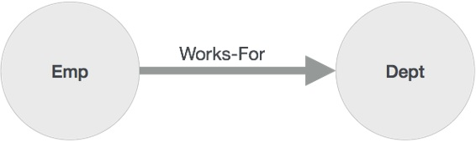
Properties
Property is a key-value pair to describe graph nodes and relationships.
Key=value
Where key is a string and value may be represented using any neo4j data types.
Relationships
Relationships are another major building block of a graph database. It connects two nodes as depicted in the following figure.
Relationship arrow mark represents a relationship from "emp" node to "dept" node, this relationship is known as an "incoming relationship" to "dept" node and "outgoing relationship" to "emp" node.

Slide 17
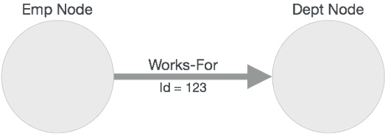
Like nodes, relationships also can contain properties as key-value pairs.
Labels
Label associates a common name to a set of nodes or relationships. A node or relationship can contain one or more labels

Slide 18
CYPHER QUERY LANGUAGE
CQL stands for cypher query language. Like oracle database has query language SQL, neo4j has CQL as query language.
Neo4j CQL
Is a query language for neo4j graph database.
Is a declarative pattern-matching language.
Follows sql like syntax.
Syntax is very simple and in human readable format.
−

Slide 19
Neo4j CQL Clauses
Following are the read clauses of neo4j cypher query language

Slide 20
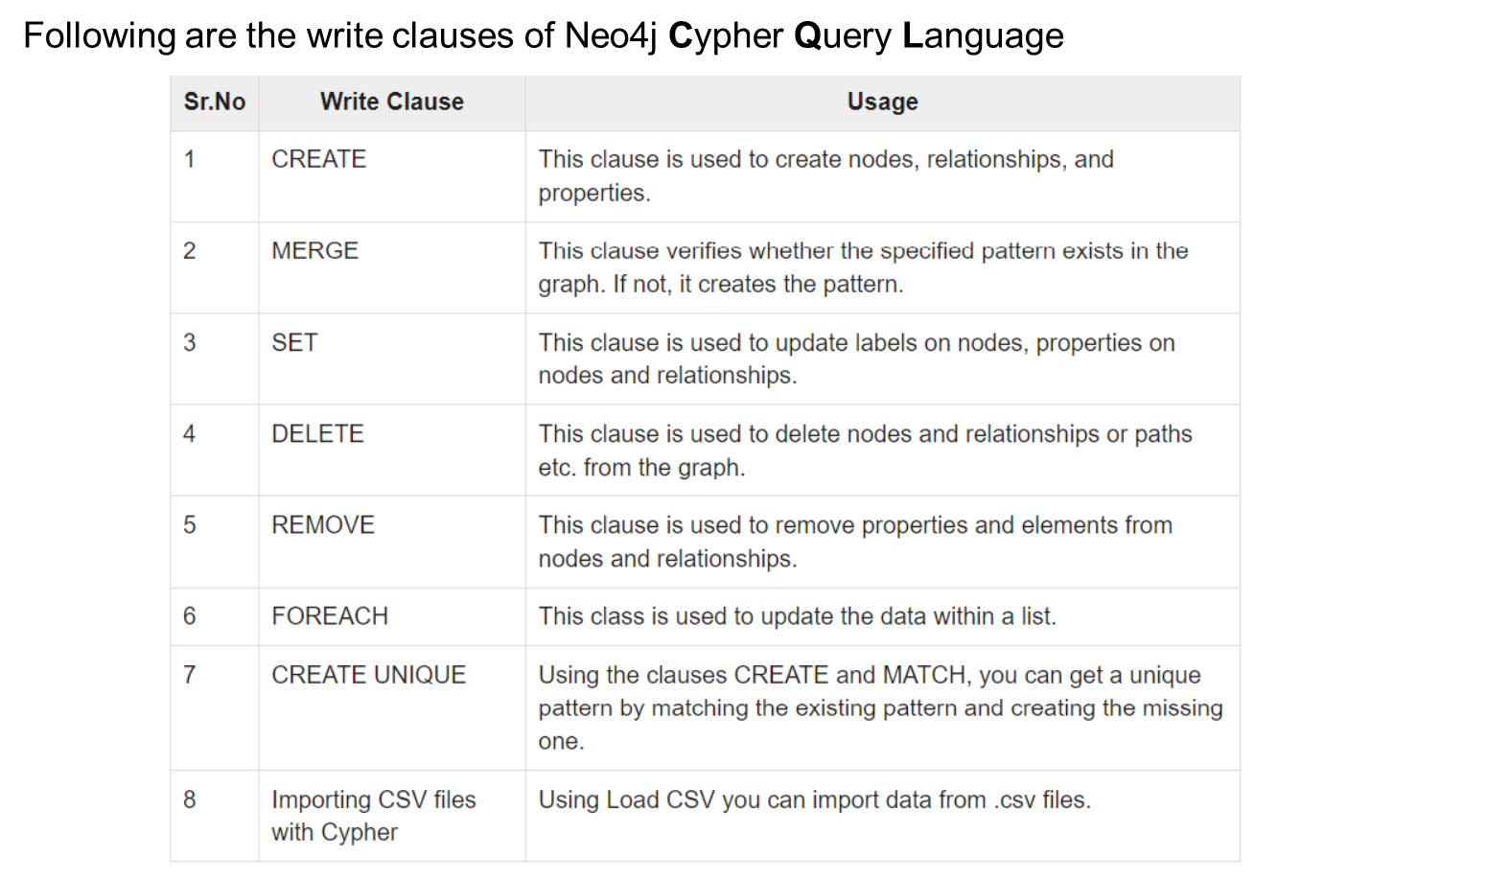

Slide 23
Neo4j Create Nodes
Node is a data or record in a graph database.
The create statement is used to create a node. You can create the following things by using CREATE statement:
Create a single node
Create multiple nodes
Create a node with a label
Create a node with multiple labels
Create a node with properties
Returning the created node

Slide 24
Create a Single Node:
CREATE (node_name);
Execute the following code to verify the creation of the node type
MATCH (n) RETURN n
Create Multiple Nodes
CREATE (node1),(node2), (node1),???..
Create (primary_node), ( secondary_node);
Create a node with a label
A label is used to classify the nodes using labels. CREATE statement is used to create a label for a node in neo4j.
CREATE (node:label)
CREATE (Kalam:scientist)

Slide 25
Create Node with Properties
CREATE (node:label { key1: value, key2: value, . . . . . . . . . })
CREATE (Ajeet:Developer{name: "Ajeet Kumar", YOB: 1989, POB: "Mau"})
Returning the created node
MATCH (n) RETURN n command is used to view the created nodes. This query returns all the existing nodes in the database.
But if you want to return the newly created node use the return command with create command:
CREATE (Node:Label{properties. . . . }) RETURN Node
CREATE (Sonoo:trainer{name: "Sonoo Jaiswal", YOB: 1987, POB: "Faizabad"}) RETURN Sonoo

Slide 26
Create Relationship
CREATE statement is used to create relationship between nodes. These relationships define direction, type and form patterns of the data.
It defines mainly three things:
Creating relationships
Creating relationships between existing nodes
Creating relationships with label and properties
Creating Relationship
CREATE (node1)-[:RelationshipType]->(node2)
CREATE (Raul:player{name: "Raul Vinci", YOB: 1973, POB: "Milan"})
CREATE (It:Country {name: "Itly"})
RETURN Raul, It

Slide 27
Create a relationship "PLAYER_OF between these two nodes as ?
CREATE (Raul)-[r:PLAYER_OF]->(It)
RETURN Raul, It
Create a Relationship between existing Nodes MATCH statement is used to create relationship between the existing nodes.
MATCH (a:LabeofNode1), (b:LabeofNode2)
WHERE a.name = "nameofnode1" AND b.name = " nameofnode2"
CREATE (a)-[: Relation]->(b)
RETURN a,b
MATCH (a:player), (b:Country) WHERE a.name = "Raul Vinci" AND b.name = "Itly"
CREATE (a)-[r: FOOTBALLER_OF]->(b)
RETURN a,b

Slide 28
Create a Relationship with Label and Properties
CREATE statement is used to create a relationship with label and properties
CREATE (node1)-[label:Rel_Type {key1:value1, key2:value2, . . . n}]-> (node2)
An example to create a relationship for a node with label and properties using the CREATE statement.
First create a node "kohli", having multiple labels
CREATE (Kohli:person:player)
CREATE (Kohli:player{name: "Virat Kohli", YOB: 1988, POB: "Delhi"})
RETURN Kohli
Create another node
CREATE (Ind:Country {name: "India"})
create a relationship with label and properties:

Slide 29
MATCH (a:player), (b:Country) WHERE a.name = "Virat Kohli" AND b.name = "India"
CREATE (a)-[r:BATSMAN_OF {Matches:5, Avg:90.75}]->(b)
RETURN a,b
Creating a complete path
CREATE statement is used to create a path. A path is formed using continuous relationship.
CREATE p = (Node1 {properties})-[:Relationship_Type]->
(Node2 {properties})[:Relationship_Type]->(Node3 {properties})
RETURN p
CREATE p = (Kohli {name:"Virat Kohli"})-[:TOPSCORRER_OF]->
(Ind {name: "India"})-[: WINNER_OF]->(Node3 {CT: "Champions_Trophy"})
RETURN p

Slide 30
Create Index
Index is a data structure which is used to improve the speed of data retrieval operations in a database.
An index can be created over a property on any node that has been given a label. Once an index is created, neo4j will manage it and keep it up to date whenever the database is changed.
CREATE INDEX ON statement is used to create an index.
CREATE INDEX ON :player(Goals)
The created schema and constraints become the part of database schema. You can check all indexes and constraints by using the :schema command. :schema

Slide 31
Create Constraints
A constraint is used to place restrictions over the data that can be entered against a node or a relationship.
There are two types of constraints in neo4j:
Uniqueness constraint: it specifies that the property must contain a unique value. (For example: no two nodes with an player label can share a value for the goals property.)
Property existence constraint: it makes ensure that a property exists for all nodes with a specific label or for all relationships with a specific type.
Create a Uniqueness Constraint
CREATE CONSTRAINT ON statement is used to create a uniqueness constraint in neo4j.
Create constraint on (kalam:president) assert kalam.Name IS UNIQUE
Use the :schema command to check the constraints.
:schema

Slide 32
Property existence constraint
Property existence constraint is used to make ensure that all nodes with a certain label have a certain property.
Select Data with MATCH
MATCH statement is used to fetch the data which matches a given criteria. MATCH statement is also used to perform some operation and return the all nodes.
Fetch a single Node
Create a node:
CREATE (a:Actors { Name : "Sonu Nigam" })
Fetch single record:
MATCH (a:Actors)
WHERE a.Name = "Sonu Nigam"
RETURN a
Fetch all Nodes
MATCH (n) RETURN n

Slide 33
MATCH Clause
MATCH clause is used to retrieve all the nodes in the neo4j database. It shows nodes as Well as relationships between them
MATCH(n) RETURN n
MATCH (a:Person)-[:KNOWS]->(b)-[:KNOWS]->(c), (a)-[:KNOWS]->(c)
WHERE a.name = 'Jim'
RETURN b, c
Draw nodes with parentheses, and relationships using pairs of dashes with greater-than or less-than signs (--> and <--). the < and > signs indicate relationship direction. Between the dashes, set off by square brackets and prefixed by a colon, we put the relationship name. Node labels are similarly prefixed by a colon.
Node (and relationship) property key-value pairs are then specified within curly braces (much like a javascript object).

Slide 34
RETURN
This clause specifies which nodes, relationships, and properties in the matched data should be returned to the client
RETURN clause is used to return nodes, relationships and properties. By using RETURN clause, you get the following things:
Return a single node.
Return multiple nodes.
Return relationships.
Return properties.
Return all elements.
Create (node:label {properties})
RETURN node

Slide 35
Return Multiple Nodes
Create (node1:label {properties})
Create (node2:label {properties})
.
.
Create (node N:label {properties})
RETURN node1, node2.... node N
Return Relationships
CREATE (node1)-[Relationship:Relationship_type]->(node2)
RETURN Relationship
Return Properties
Match (node:label {properties . . . . . . . . . . })
Return node.property

Slide 36
Return All Elements
Match m = (n {name: "India", result: "Winners"})-[r]-(x)
RETURN *
Other cypher clauses
The other clauses we can use in a cypher query include:
Where
Provides criteria for filtering pattern matching results.
Create and create unique
Create nodes and relationships.
Merge
Ensures that the supplied pattern exists in the graph, either by reusing existing
Nodes and relationship
With
Chains subsequent query parts and forwards results from one to the next. Similar
To piping commands in unix.

Slide 37
WITH clause is used to chain the queries together. It can be used with other clauses as well as.
MATCH (n)
WITH n
ORDER BY n.property
RETURN collect(n.property)
ORDER BY
The ORDER BY clause is used to arrange the result data in order.
MATCH (n)
RETURN n.property1, n.property2 . . . . . . . .
ORDER BY n.property

Slide 38
Thank You

